Slide 1

Simplified Data Encryption Standard

Slide 2
OUTLINE
Definition of SEDS
Results
RTL Model
& Netlist
Verification

Slide 3
Definition of SDES

Slide 4
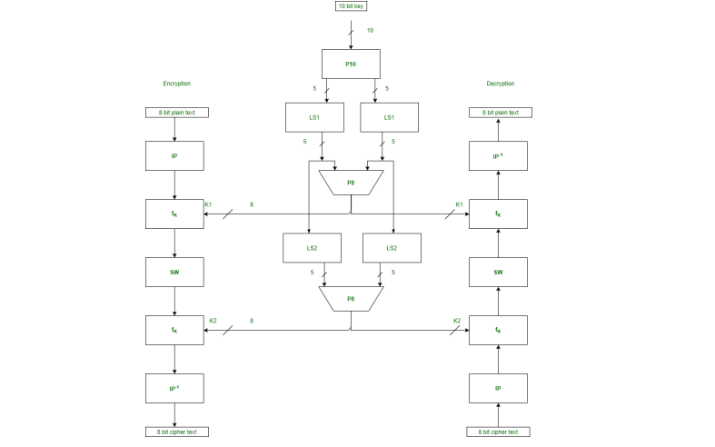
What is S-DES?
simplified version of the Data Encryption Standard (DES) algorithm. It's primarily used for educational purposes due to its simplicity. S-DES operates on small blocks of data (8 bits) and uses a relatively short key (10 bits) compared to DES.

Slide 5
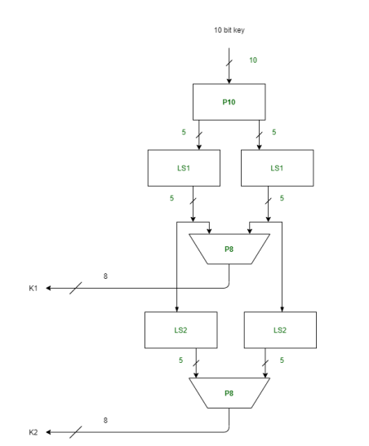
Key Generation
Contains 3 Functions:
Permutation P10.
Permutation P8.
Shift Left.

Slide 6
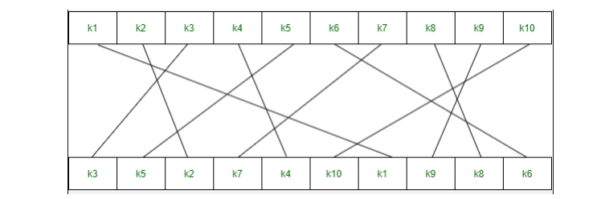
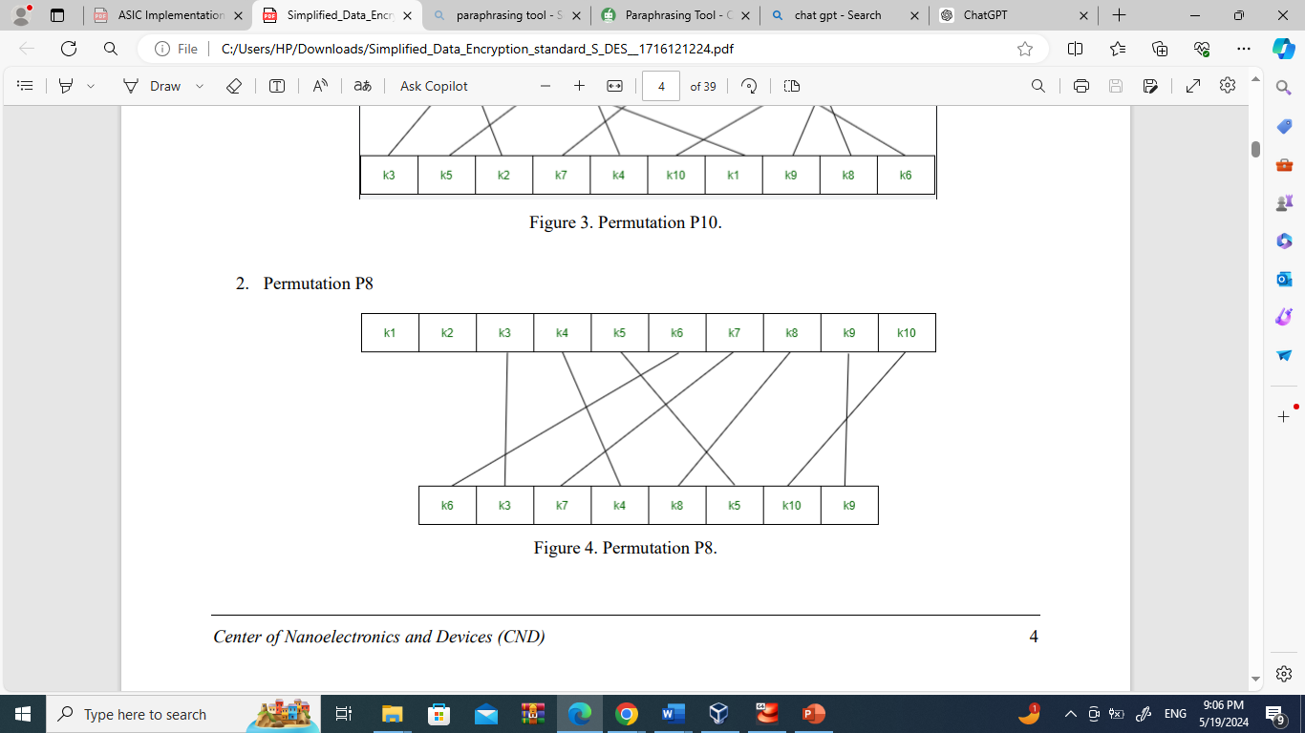
Key Generation
Permutation P10:
Permutation P8:

Slide 7
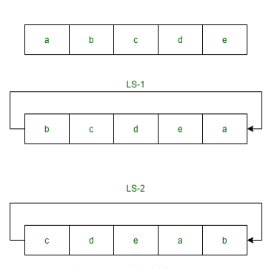
Key Generation
Shift Left:

Slide 8
Encryption
Initial permutation(IP)
Complex function (fk)
Switch (SW)
Inverse of Initial Permutation (IP-1)

Slide 9
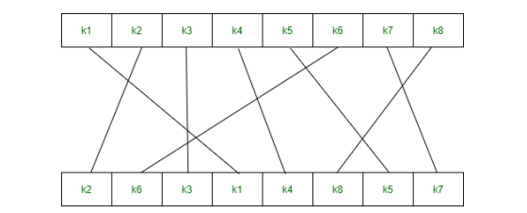
Initial permutation(IP)
Encryption

Slide 10
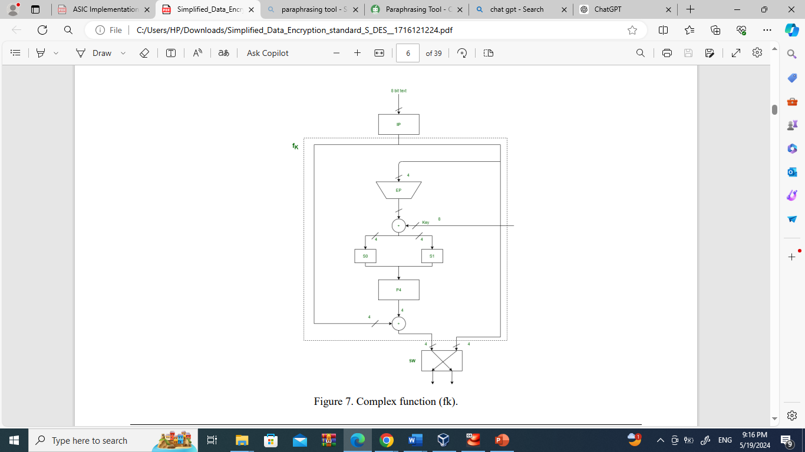
Encryption
Complex function (fk)
Consists of:
Expanded Permutation (EP)
S-boxes (S0 and S1)
Permutation P4

Slide 11
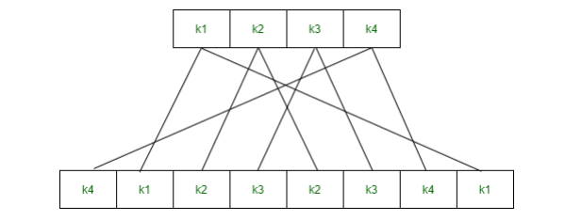
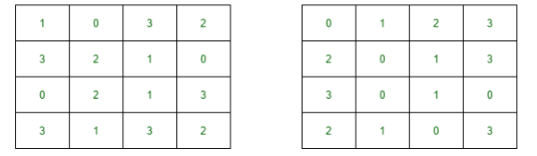
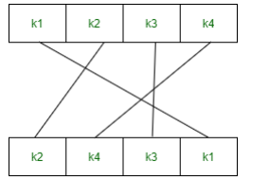
Encryption
Complex function (fk)
Expanded Permutation (EP)
S-boxes (S0 and S1)
Permutation P4

Slide 12
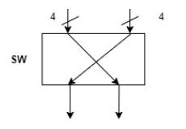
Switch (SW)
Encryption

Slide 13
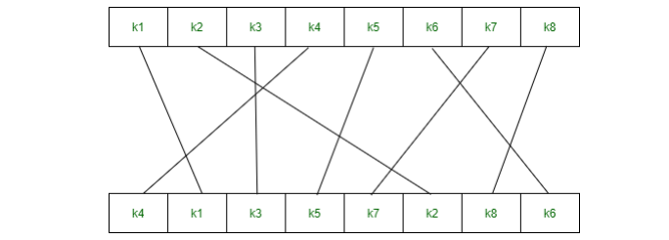
Encryption
Inverse of Initial Permutation (IP-1)

Slide 14
RTL MODEL

Slide 15
RTL Model:
IP
Key Generation
Complex Function
Swap
IP inverse
SDES

Slide 16
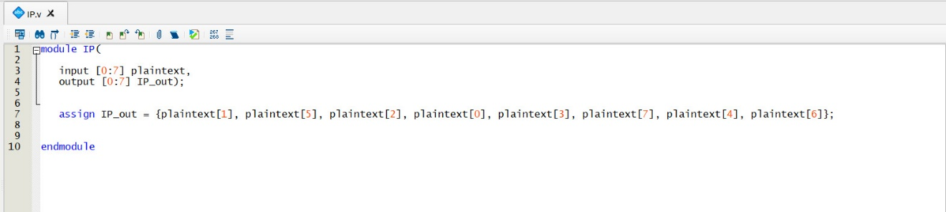
IP

Slide 17
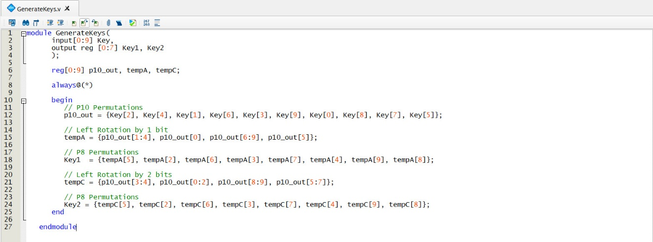
Key Generation

Slide 18
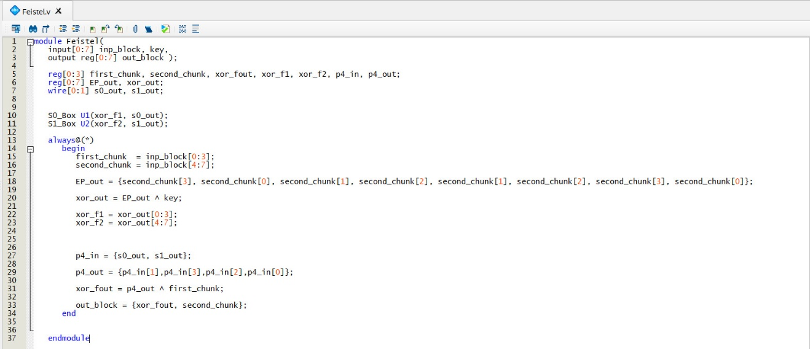
Complex Function

Slide 19
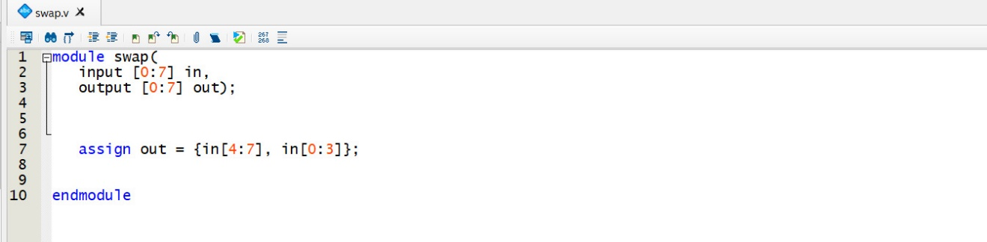
Swap

Slide 20
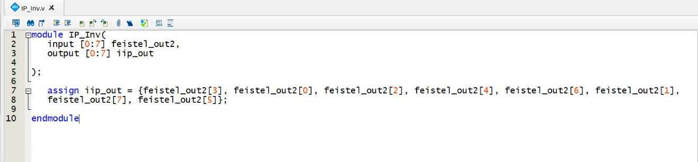
IP inverse

Slide 21
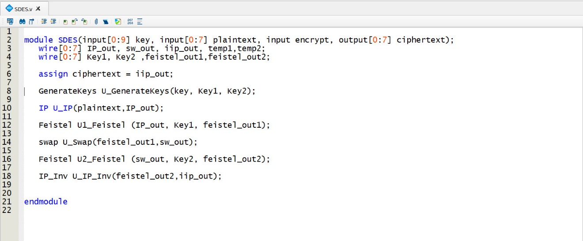
SDES

Slide 22
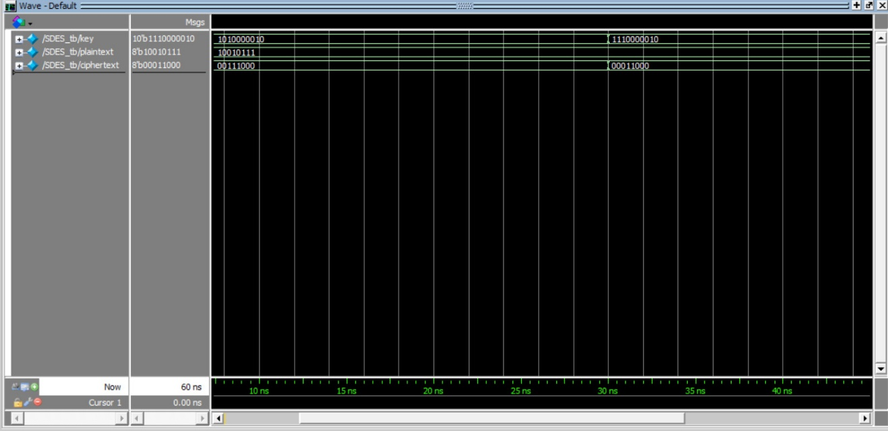
Simulation
Plain Text : 10010111
Key sample 1 : 1010000010 Cipher Text : 00111000
key sample 2 : 1010000010 Cipher Text : 00011000

Slide 23
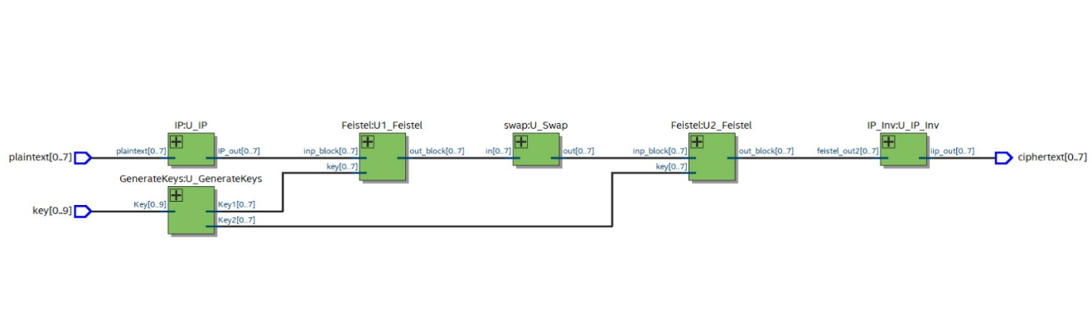
Netlist Results:
SDES:

Slide 24
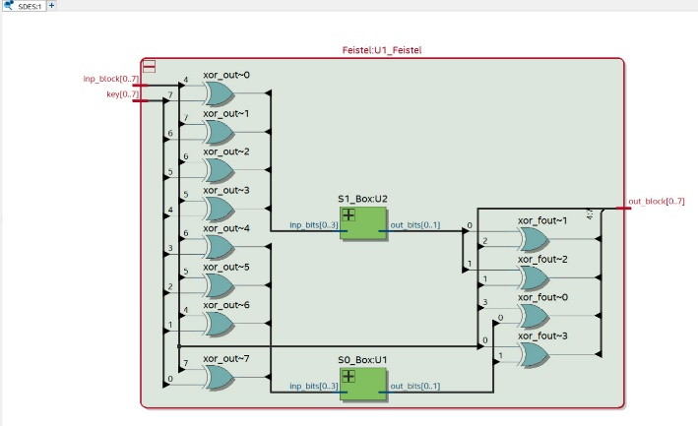
Complex Function
Netlist Results:

Slide 25
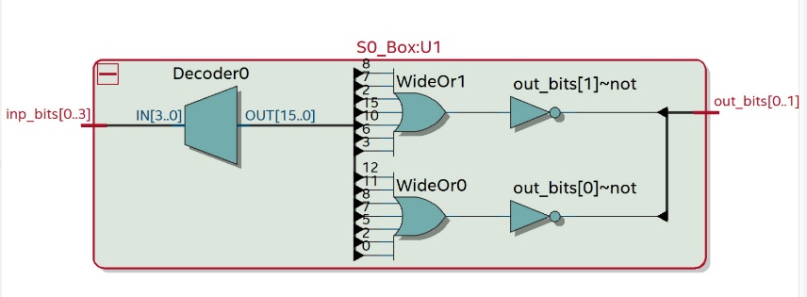
S0 Box
Netlist Results:

Slide 26
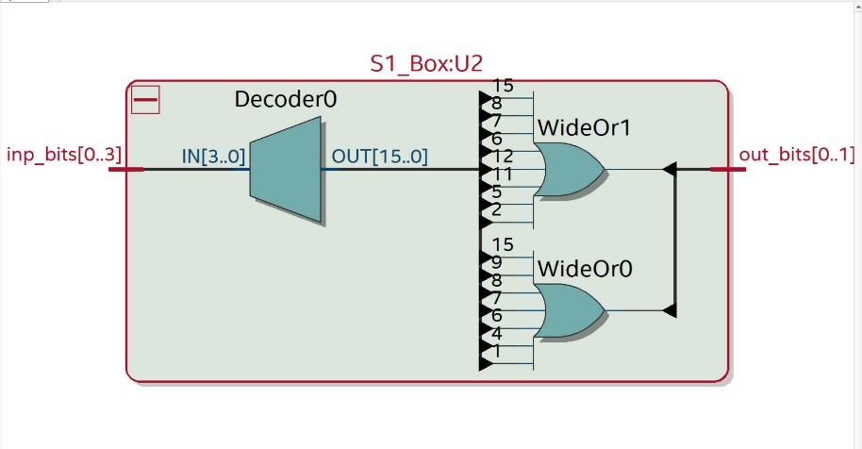
S1 Box
Netlist Results:

Slide 27
LAYOUT

Slide 28
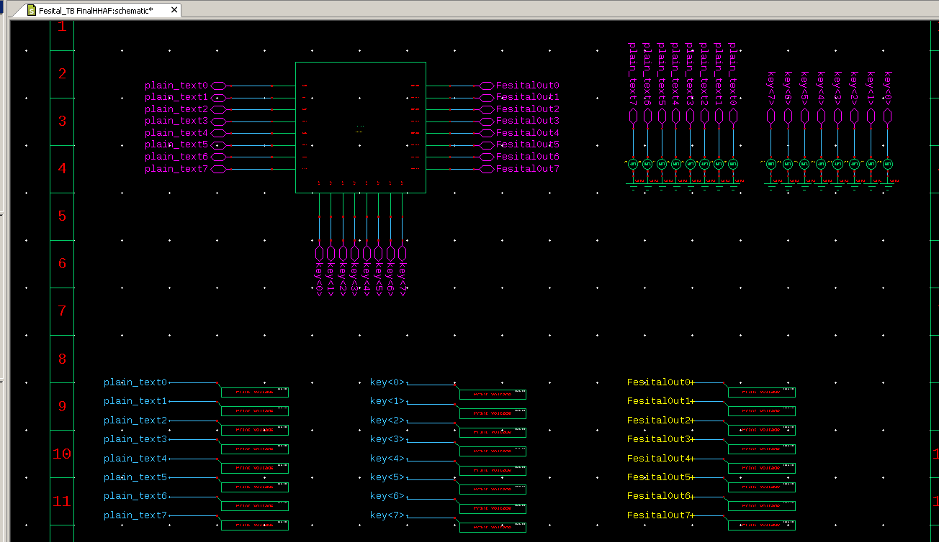
Circuit Implementation
Complex Function TB Block

Slide 29
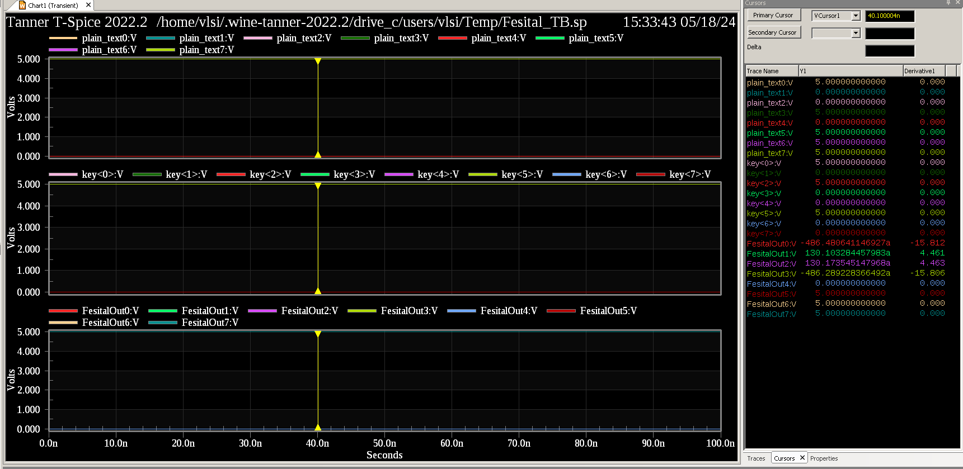
Simulation Results

Slide 30
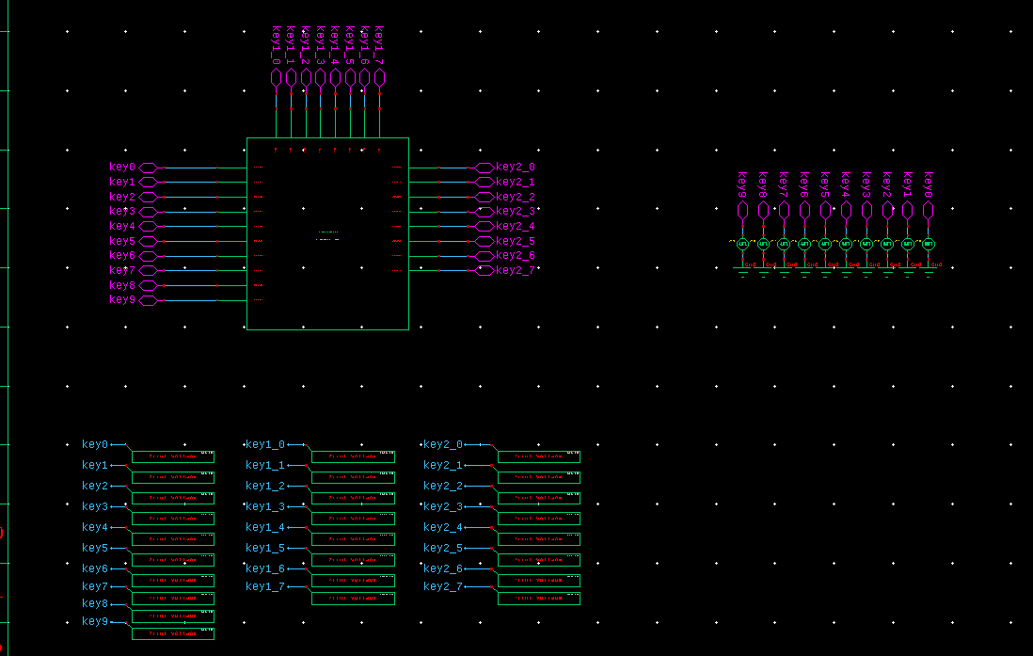
Key Generation TB Block

Slide 31
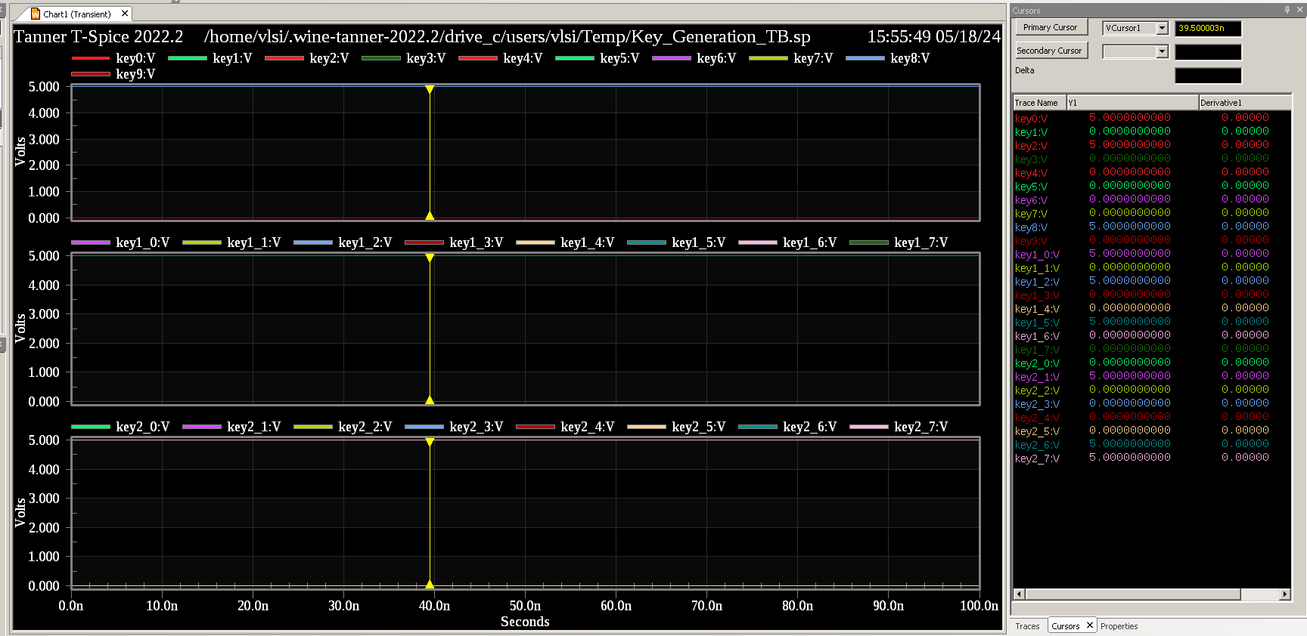
Simulation Results

Slide 32
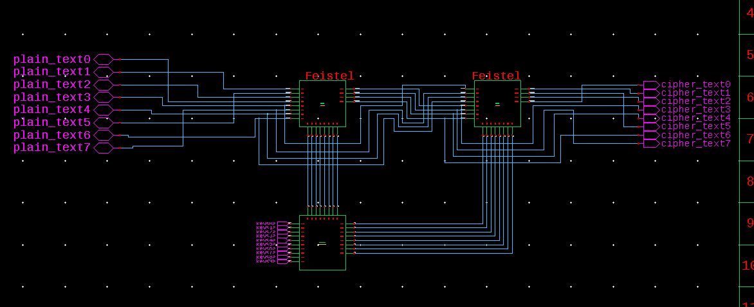
Final S-DES

Slide 33
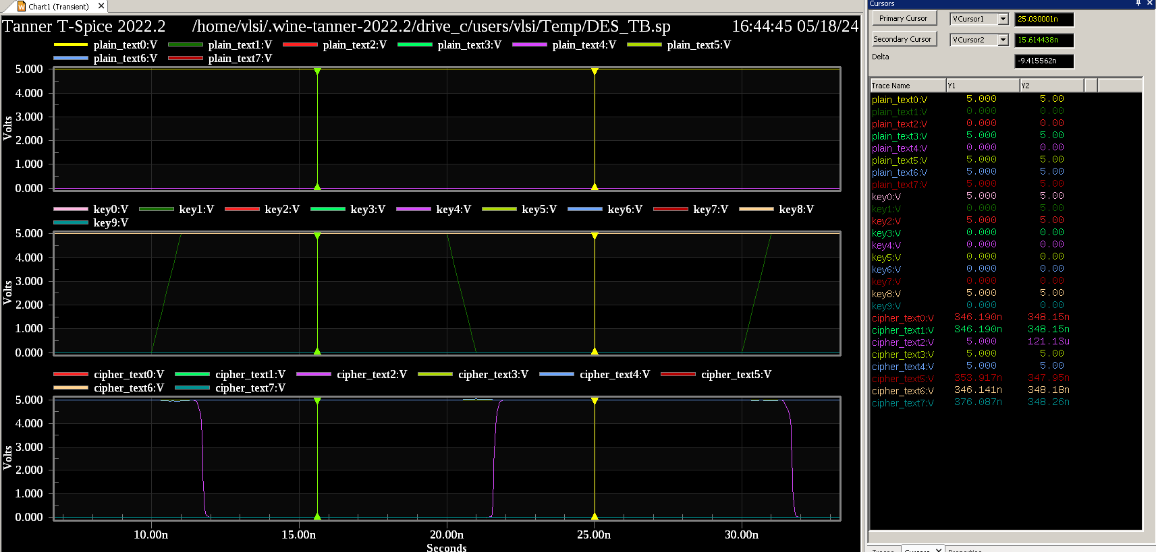
Testbench Results

Slide 34
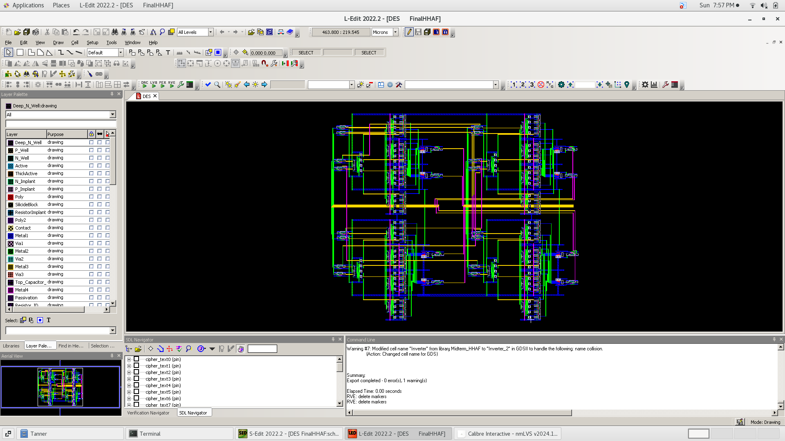
Layout

Slide 35
verification

Slide 36
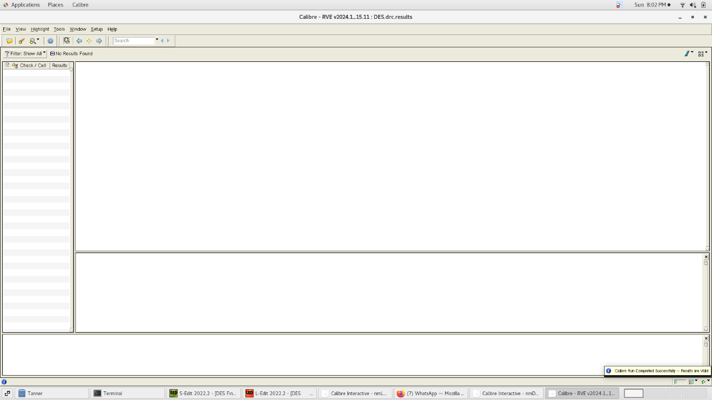
Layout DRC

Slide 37
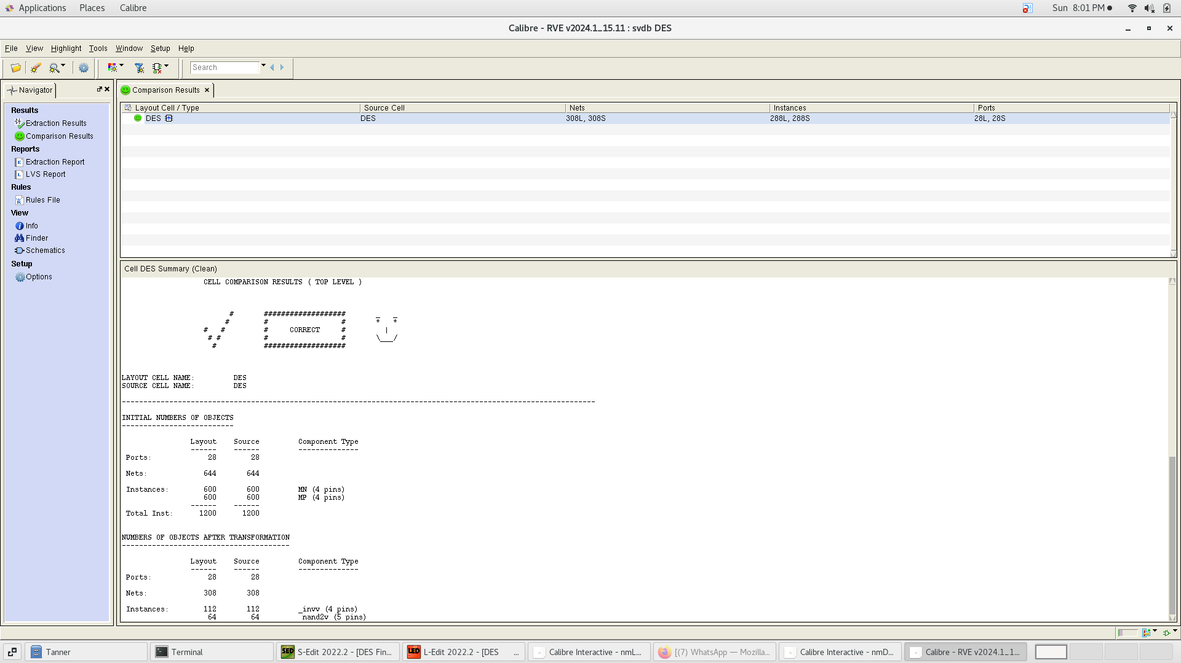
Layout LVS

Slide 38
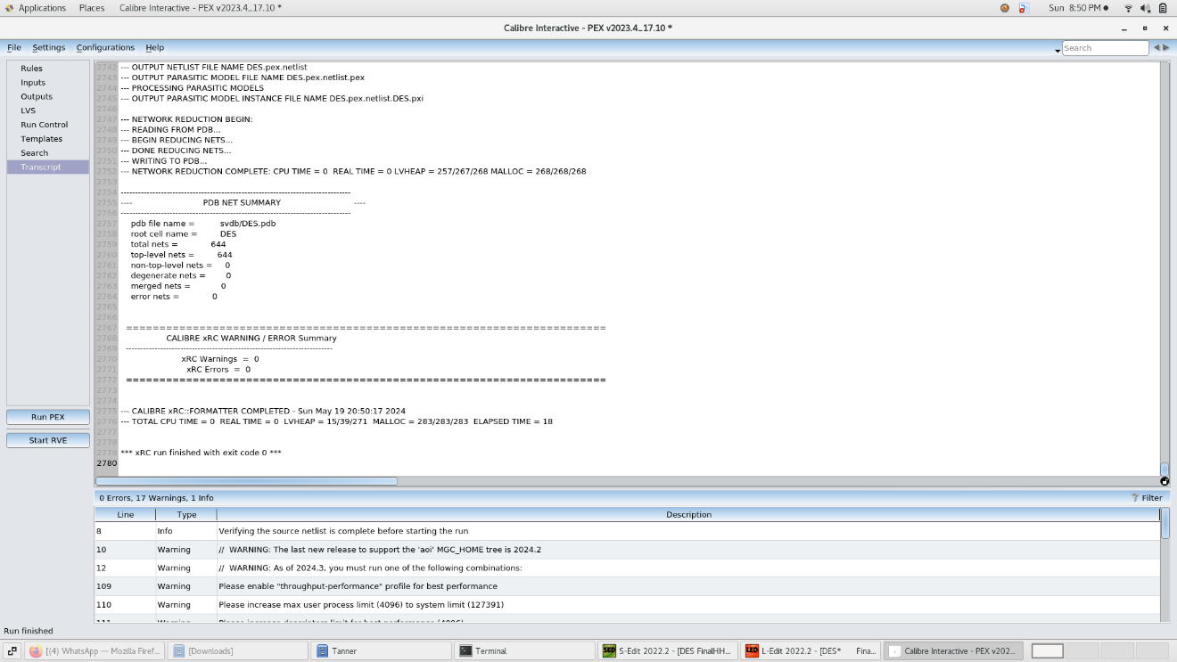
Layout PEX

Slide 39
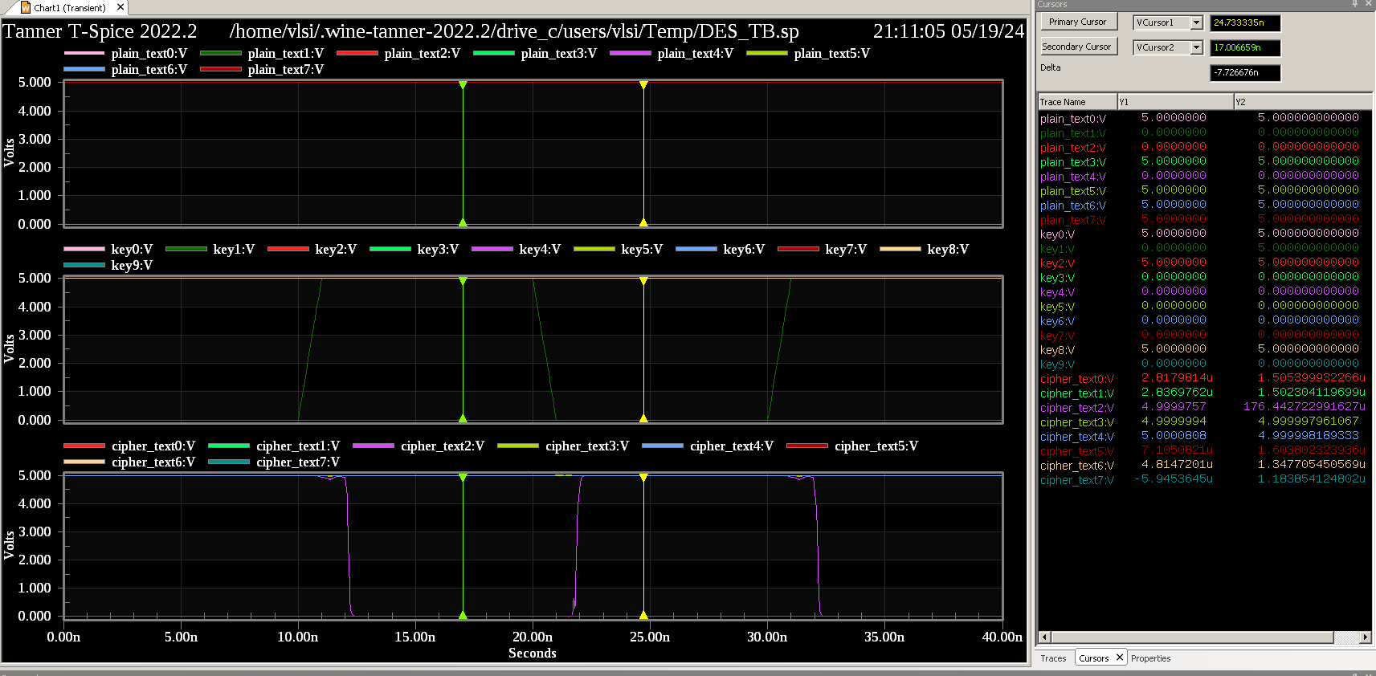
Post Layout Simulation:

Slide 40
Thank You

